Slide 1
Starting your new restaurant in Mumbai
By: Rawand Guerfel

Slide 2
Introduction
One of the biggest financial hub of the world: Mumbai
The most densely populated cities in the globe.
As multi-cultural city, Mumbai attract so many people for either working or enjoying their holidays.
Thus, the aim of this project is to study the Mumbai neighborhoods in order to determine suitable locations for new restaurant.

Slide 3
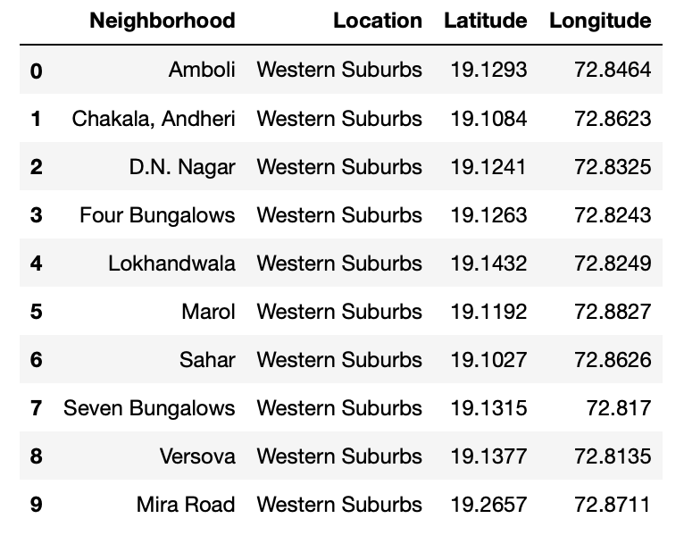
Data Collection
The following data was collected for this project:
Neighborhood data of Mumbai from https://en.wikipedia.org/wiki/List_of_neighborhoods_in_Mumbai
Geographical coordinates of Mumbai and all neighborhoods in Mumbai using GeoPy and Geocoder libraries in python
Venue data for all neighborhoods in Mumbai using Foursquare API
The data was then cleaned to produce the final datasets shown in the upcoming slides

Slide 4
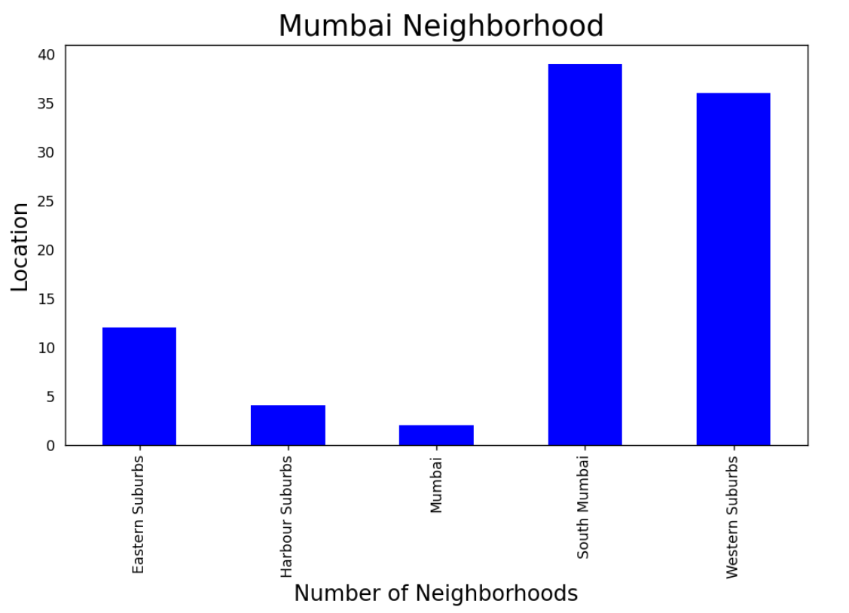
Methodology
Data Visualization
Mumbai neighborhoods data was plotted for providing a better understanding
The graph alongside depicts the number of neighborhoods in each location of Mumbai
All neighborhoods on the outskirts of the city have been grouped as “Mumbai”
Western Suburbs and South Mumbai contain the highest number of neighborhoods

Slide 5
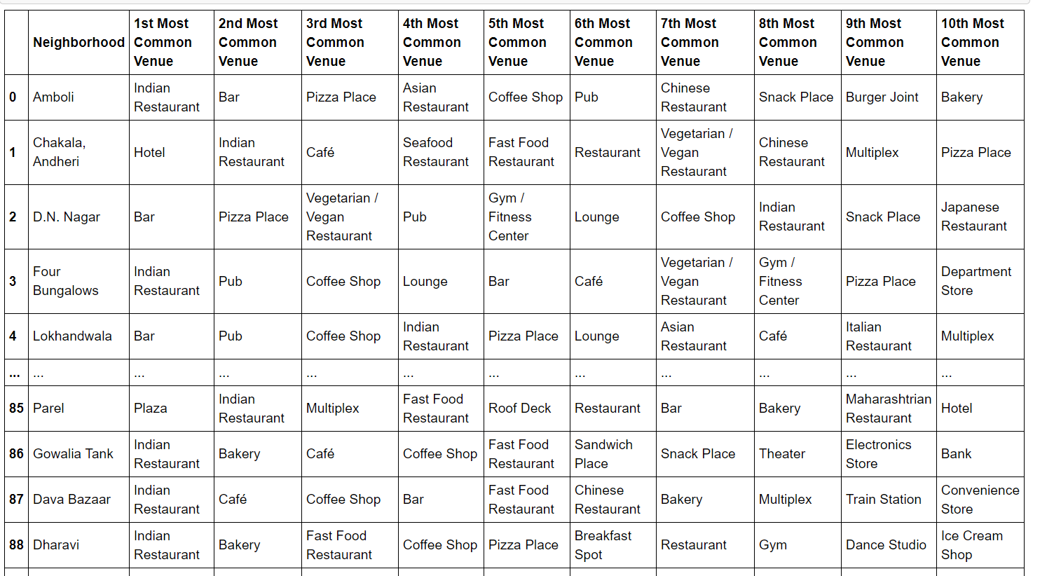
Results

Slide 6
Results 2
As a result we are exposing the most common venues for each neighborhood. The same would be healthy and first data driven decision making followed process to choose the right place and type for your next restaurant.

Slide 7
Conclusion
We have successfully analysed the neighbourhoods in Mumbai, India for determining which would be the best neighbourhoods for opening a new restaurant.
The stakeholders and investors can further tune this by considering various other factors like transport.

